Slide 1

Fairness in ML Overview
Rayid Ghani and Kit Rodolfa

Slide 2
Reminders
This week:
Rescheduling Pre-Processing Presentations to Nov 23
Coming up next week:
Module 3 Presentations

Slide 3
Scope
Data
Exploration
Modeling
Get Data
Store Data
Link Data
Rows
Features
Labels
Model Selection
Train-Test Splits
Performance Metrics
Model Interpretation
Entities
temporal
Spatial
…
Models
Dealing with Bias and Fairness
Field Trial Design
Deployment
Monitoring
Goals, Actions, Data, Analysis, Ethics

Slide 4
We know data and ML can help improve society but we have to do it responsibly and ethically

Slide 5
We need to be ok with not having answers but raising more questions that can be empirically informed

Slide 6
Most of these questions are not new
Ethical issues have always existed in every decision-making process
Why are we talking about them in this class now?

Slide 7
Most of these questions are not new
Ethical issues have always existed in every decision-making process but we are dealing with them now at a different scale and with a more data-driven view

Slide 8
Our policies need to reflect our values
What do we mean by equity?
Is it ok to (reverse) discriminate against one group to reach equity?
Should our right to privacy matter more than our right to life? Or to healthcare?
Should we be allowed to use someone’s data just because it’s accessible to us?
Is predictive policing always bad?

Slide 9
We need to think of & include the perspectives of different groups
Decisionmakers
Public
Media
Analysts

Slide 10
Rawls’s Theory of Justice
Why did we ask you to read a moral philosophy text?
Moral philosophy is much more about frameworks to help approach tough problems and balance competing obligations than clear-cut answers
Rawls is far from the only voice here and many other perspectives are well worth exploring: utilitarianism (Singer), deontology (Kant), Scanlon, Sen, etc.

Slide 11
Rawls’s Theory of Justice
Make rules from the “original position” under a “veil of ignorance”
Rawls’s conclusions: equality in rights/duties & the difference principle
Maximize the position of the least-well-off in society (“maximin”)

Slide 12
Some questions we should be asking

Slide 13
Some questions we should be asking
Are you using data for purposes it’s intended for?
How are you protecting the data?
Do the people who “own” the data know you’re using it?
Do you have their permission? How was it obtained?
What actions are you taking on individuals based on this data?
Do the people you’re targeting know why and if they’re being targeted?
What recourse do they have?
Would it make the front page of NYT if they found out what you’re doing?

Slide 14
Data and AI Ethics Issues
Privacy
Data Ownership
Bias, Equity, & Fairness
Transparency
Trustworthiness and Accountability

Slide 15
Data and AI Ethics Issues
Privacy
Data Ownership
Bias, Equity, & Fairness
Transparency
Trustworthiness and Accountability

Slide 16
How do we build AI systems that are fair and lead to equity?
What do we mean by equity?
How do we balance equity with other goals? Efficiency? Effectiveness?
Who do we want to be fair to? At what expense?
How do we define fairness?
Connecting equity goals in policy domains to “achievable” fairness metrics
Fairness Tree to help policymakers go from equity outcomes to AI models
Measuring Fairness
Understanding the root causes of bias
Improving the AI systems we develop
Mitigating the impact of unfair models to achieve fair outcomes
Monitoring and Evaluating

Slide 17
Common misconceptions in the real world
If I don’t use race in my analysis/models, then my analysis/models can’t be racist
If I use race in my models, then those models are always racist
If my actions aren’t happening on individuals, then I don’t need to worry about bias

Slide 18
Equity Audit Framework
Awareness Equity | Do all people have equal awareness about the existence of this service?
Access Equity | Is this service equally available/accessible to all users who would need it?
Knowledge Equity | Do all people who need this service know how to access it?
Consumption Equity | Is everyone who needs it consuming it (or being provided) equally?
Effectiveness Equity | Is it equally effective for everyone who is consuming it?
Outcome Equity | Is it resulting in equitable outcomes for everyone who needs it or is consuming it?

Slide 19
Fairness Research Agenda
Define (equity)
Understand
(root causes)
Improve (fairness)
Measure/ Detect (bias)
Mitigate
(the impact)
Monitor/
Evaluate
The focus is not on making the ML model fair but rather on making the overall system and outcomes fair

Slide 20
Where does Bias in ML/AI-based Systems come from?
The world
System Developers (Intentional bias)
Complexity of the System
Data
Sample Bias
Measurement Bias
Label Bias
Complexity or flaws in Methodology
Entire analysis/data pipeline
Action/Intervention Bias

Slide 21
Bias can be introduced in every step of the ML pipeline
Get Data
Store and Link Data
Process Data
Explore Data
Modeling
Communicate
Maintain
Deploy
Evaluate & Select
Test

Slide 22
What do we mean by “bias”? How can we measure it?

Slide 23
Many Bias Measures: How do we select what we care about?
Statistical/Demographic Parity
Impact Parity
False Discovery Rate Parity
False Omission Rate Parity
False Positive Rate Parity
False Negative Rate Parity
...

Slide 24
Many Bias Measures: How do we select what we care about?

Slide 25
Why do we have to choose?

Slide 26
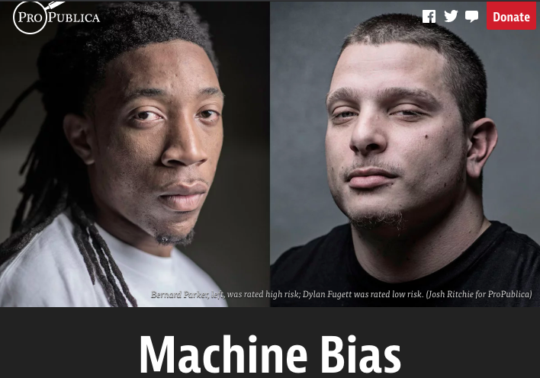
Incompatibility Between Fairness Metrics

Slide 27
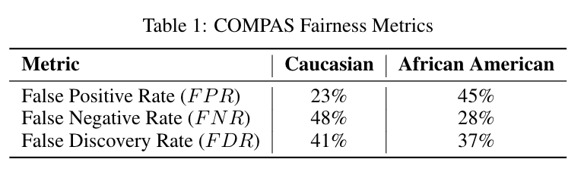
Incompatibility Between Fairness Metrics

Slide 28
Incompatibility Between Fairness Metrics
ProPublica identified considerable disparities:
The algorithm was twice as likely to incorrectly predict black individuals were at high risk of recidivating (FPR)
It was also nearly twice as likely to incorrectly predict white individuals were at low risk of recidivating (FNR)

Slide 29
Incompatibility Between Fairness Metrics
However, the creator of the algorithm pointed out that the algorithm is well-
balanced across races on precision (equivalently, FDR), claiming this is the
correct measure of fairness in this context.

Slide 30
Incompatibility Between Fairness Metrics
Who is right?
Is the COMPAS algorithm biased?
Can’t the algorithm achieve both measures of fairness at the same time?

Slide 31
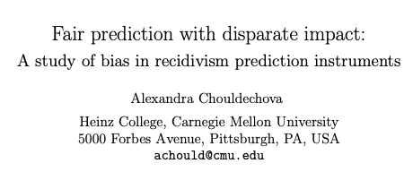
Incompatibility Between Fairness Metrics

Slide 32
Incompatibility Between Fairness Metrics

Slide 33
Incompatibility Between Fairness Metrics
False Positive Rate
Among all actual 0’s,
fraction predicted to be 1
False Negative Rate
Among all actual 1’s,
fraction predicted to be 0
Prevalence
Fraction of
actual 1’s in
population
False Discovery Rate
Among all predicted 1’s,
fraction that are actual 0’s
=(1 – precision)

Slide 34
Incompatibility Between Fairness Metrics
If prevalence is
unequal across
groups...

Slide 35
Incompatibility Between Fairness Metrics
If prevalence is
unequal across
groups...
…and FDR (or precision)
is equal across groups...

Slide 36
Incompatibility Between Fairness Metrics
If prevalence is
unequal across
groups...
…and FDR (or precision)
is equal across groups...
…then either FPR or FNR can be equal across groups, but not both

Slide 37
So… what does this mean?

Slide 38
So… what does this mean?
Sadly, no… we can’t have it all!
But this also doesn’t mean fairness is unachievable or we shouldn’t bother.
Instead, it means we have to carefully consider and choose the appropriate fairness metrics for our context

Slide 39
Some Motivating Case Studies
Lead Poisoning
Blight Violations
Student Tutoring

Slide 40
Some Motivating Case Studies
Assessing damage from natural disasters via social media
Bank loan denial decisions based on default risk
Prioritizing housing inspections based on risk of lead poisoning

Slide 41
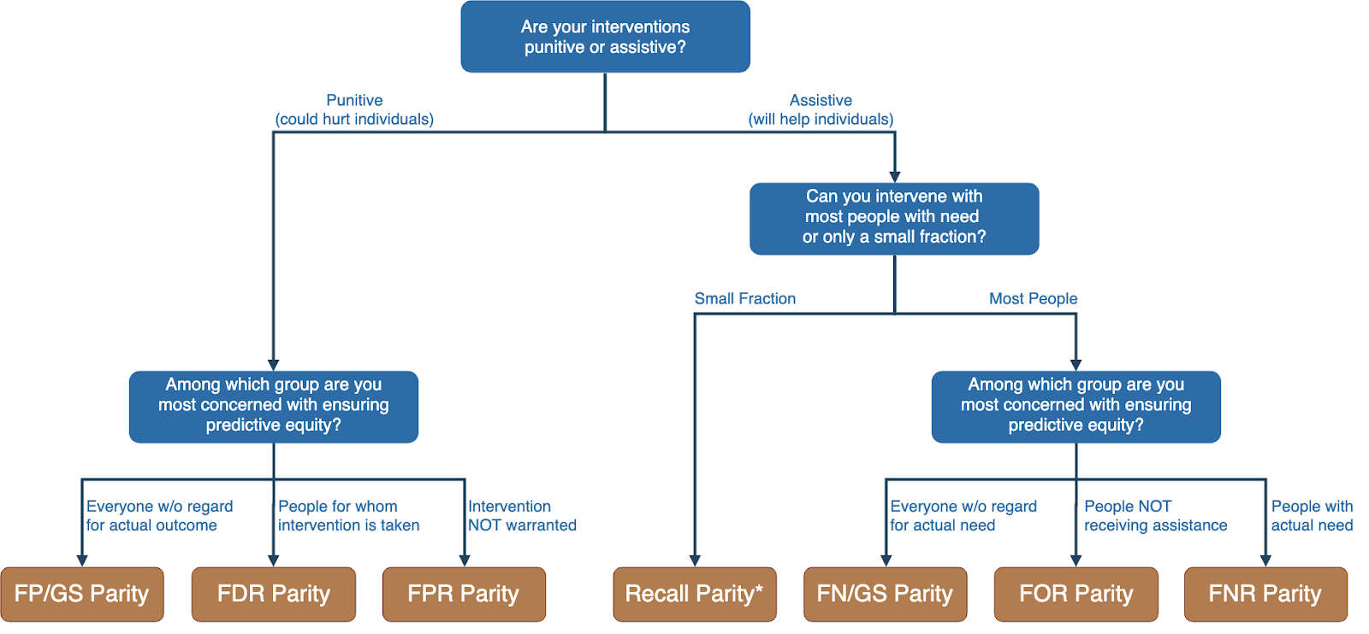
Translating project goals to fairness metrics

Slide 42
Is the fairness tree “the answer”?
No… but it’s intended as a starting point to help guide a conversation between ML experts, policy makers, and those affected by the decisions.
Ultimately, the choice of fairness metric(s) is highly dependent on context and stakeholder values.

Slide 43
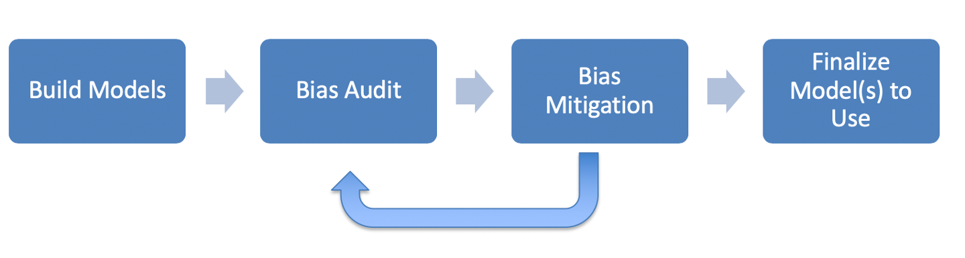
ML Fairness Workflow

Slide 44
How can we reduce bias in ML models?
Fix the world
Pre-Processing: Fix the input data
Remove sensitive attributes (and correlated ones)
Resample and/or reweight protected groups
In-Processing: Optimize for fairness in model training
Post-Processing
Choose fair models during model selection
Post-hoc adjustments to ‘de-bias’ model scores

Slide 45
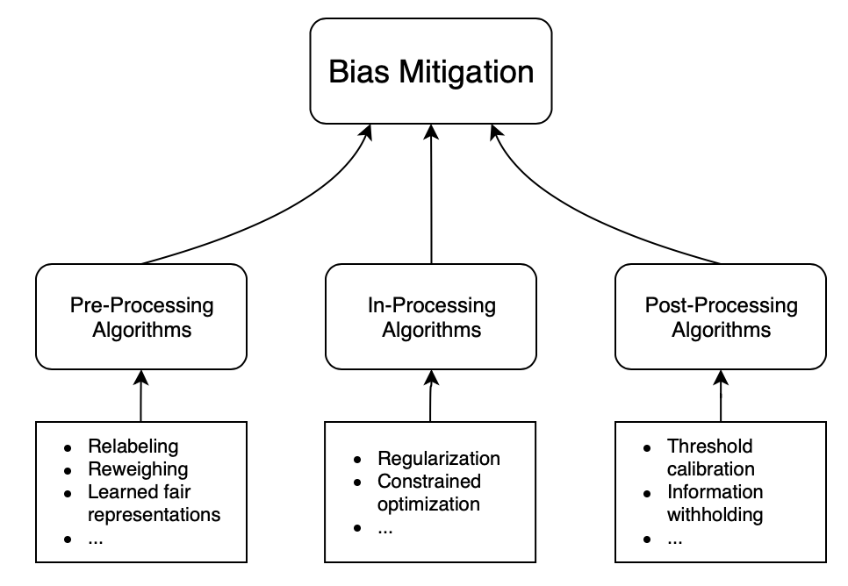
How can we reduce bias in ML models?

Slide 46
What’s the Best Approach?
We’ll explore this question through the lens of your group projects in the next several sessions…

Slide 47
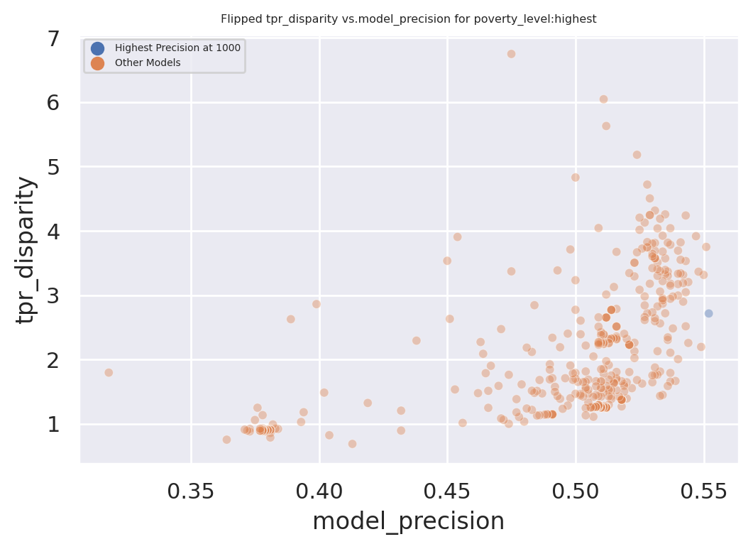
Exploring Trade-Offs
Each point is a different
model specification
Disparity
Precision@k

Slide 48
Exploring Trade-Offs
Each point is a different
model specification
Points further to the right
are more accurate
Disparity
Precision@k

Slide 49
Exploring Trade-Offs
Each point is a different
model specification
Points further to the right
are more accurate
Points closer to 1 on the
y-axis are more fair
Disparity
Precision@k

Slide 50
Exploring Trade-Offs
Disparity
“Best” model just based
on top k precision
Precision@k

Slide 51
Exploring Trade-Offs
Disparity
Pareto Frontier
Precision@k

Slide 52
Exploring Trade-Offs
Disparity
Our hope:
Fairness-improving
methods can expand this
frontier by adding new
points
Precision@k

Slide 53
Reminders
This week:
Rescheduling Pre-Processing Presentations to Nov 23
Coming up next week:
Module 3 Presentations

Slide 54
Appendix

Slide 55
Legal and Social Principles
Choices about fairness and equity are implicit in any decision process but being made explicit by the growing use of algorithmic decision support.

Slide 56
Legal and Social Principles
Choices about fairness and equity are implicit in any decision process but being made explicit by the growing use of algorithmic decision support. What implicit choices about fairness are encoded when we say…
Beyond a reasonable doubt? (e.g., criminal court)
The preponderance of evidence? (e.g., civil court)
Probable cause? (e.g., indictment by grand jury)
Innocent until proven guilty?

Slide 57
Legal Perspectives and Challenges
Title VII of US Civil Rights Act – Job Discrimination
Disparate Treatment (intentional discrimination)
Disparate Impact (regardless of intention)
14th Amendment
Equal Protection (under laws and government actions)
“Strict Scrutiny” Standard: compelling state interest, narrowly tailored, and least restrictive means
Notes:
14th Amendment often interpreted to prohibit racial classification in most cases (that is, taking race into account in state decision-making) as well as racial intentions/discriminatory purpose

Slide 58
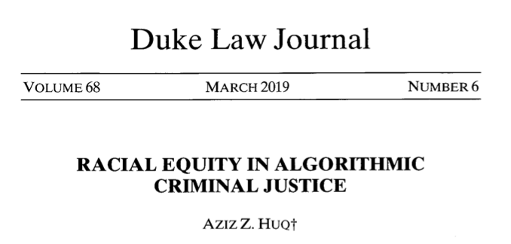
Legal Perspectives and Challenges

Slide 59
Legal Perspectives and Challenges
What Challenges Does Huq Identify Applying Current Legal Standards to Algorithmic Decision Making?

Slide 60
Legal Perspectives and Challenges
What Challenges Does Huq Identify Applying Current Legal Standards to Algorithmic Decision Making?
Expanded scale and reach of state power
Durability of errors – need for special skills to update/fix problems
What does “discriminatory intent” mean in this context?
Unclear how to apply “anticlassification” standard of equal protection

Slide 61
Legal Perspectives and Challenges
Difficulties with Equal Protection’s “Anticlassification” Standard:
Simply omitting race as a feature doesn’t ensure an algorithm is “colorblind” – too much correlated information in other features
Accounting for race may in fact be needed to decrease disparities

Slide 62
Legal Perspectives and Challenges
Drug Possession Rates
 | Black | White
Baseball Cap | 0% | 100%
No Cap | 2% | 2%

Slide 63
Legal Perspectives and Challenges
Drug Possession Rates
 | Black (25% of Pop.) | White (75% of Pop.)
Baseball Cap | 0% | 100%
No Cap | 2% | 2%
Race-Blind Policy:
75% Precision
Many Needless Searches of Minorities

Slide 64
Legal Perspectives and Challenges
Drug Possession Rates
 | Black (25% of Pop.) | White (75% of Pop.)
Baseball Cap | 0% | 100%
No Cap | 2% | 2%
Race-Aware Policy:
100% Precision
No Needless Searches of Minorities

Slide 65
Legal Perspectives and Challenges
How does Huq suggest modifying our criteria for assessing discrimination in this new context?

Slide 66
Legal Perspectives and Challenges
“Rather than asking about abstract definitions of fairness, a criminal justice algorithm should be evaluated in terms of its long-term, dynamic effects on racial stratification… [and] focus on the net burden thereby placed on the racial minority.”

Slide 67
Three Concepts of Fairness in ML
We’ve focused here on the concept of group fairness – balancing aggregate metrics across groups
Some also study the concept of individual fairness – that similar individuals should be treated similarly
An important related line of work concerns counterfactual fairness – how would your prediction if you were a member of a different group?

Slide 68
Practical Challenges with Individual Fairness
How do you measure “similarity”? Over what distance metric and what features?
Individual fairness doesn’t guarantee group fairness (but also vice-versa)
In the light of existing or historical discrimination, the protected attribute / group membership might be an important measure of dissimilarity in itself

Slide 69
Where does this leave us?
What can we do to understand bias and improve fairness of our systems?
Bias and equity audits
Try to fix the input data
Optimize for fairness in model training
Choose fair models during model selection
Post-hoc adjustments to de-bias model scores
Measure relative effectiveness of interventions across groups and develop better-tailored interventions

Slide 70
Post-Processing
Case Study

Slide 71
Case Study: Post-hoc Adjustments and Policy Goals
Cycle of Incarceration
UNMET
NEEDS
MISDEMEANOR
ARREST
JAIL
worsening or failing to improve

Slide 72
Case Study: Post-hoc Adjustments and Policy Goals
Breaking the Cycle
UNMET
NEEDS
X
MISDEMEANOR
ARREST
JAIL
TAILORED
INTERVENTION

Slide 73
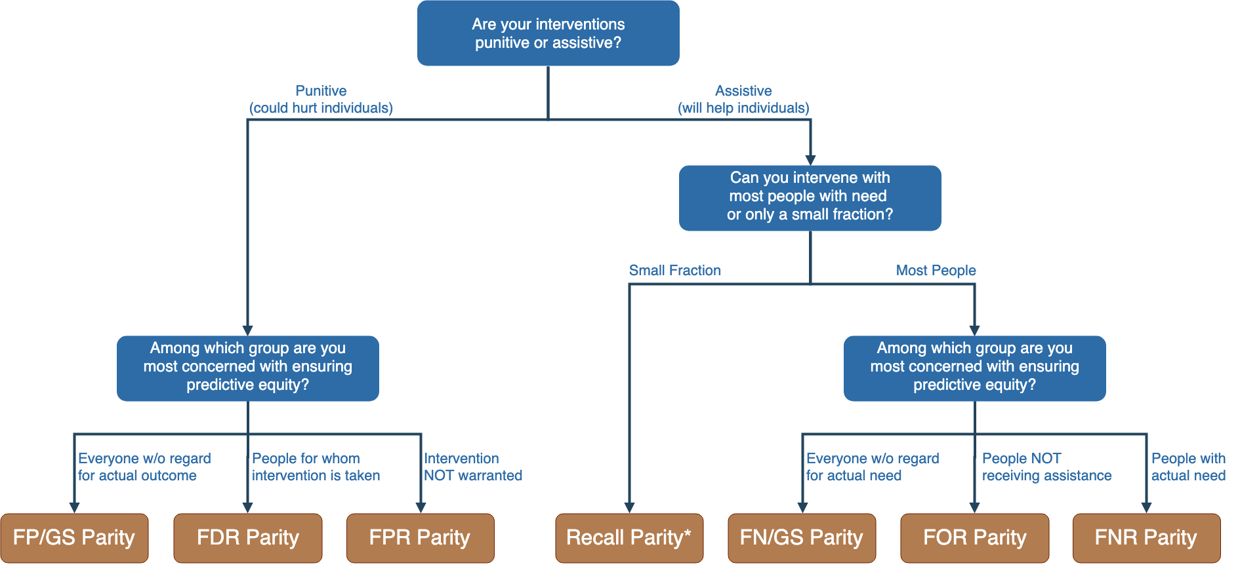
Notes:
Context-dependence of fairness definition
Idea of fairness tree is starting point for conversations with stakeholders, help guide discussion
In assistive program with resource constraints, focus on recall parity (equivalent to equality of opportunity discussed by Hardt and others --- also “sensitivity” and TPR and 1-FNR)

Slide 74
Notes:
Context-dependence of fairness definition
Idea of fairness tree is starting point for conversations with stakeholders, help guide discussion
In assistive program with resource constraints, focus on recall parity (equivalent to equality of opportunity discussed by Hardt and others --- also “sensitivity” and TPR and 1-FNR)

Slide 75
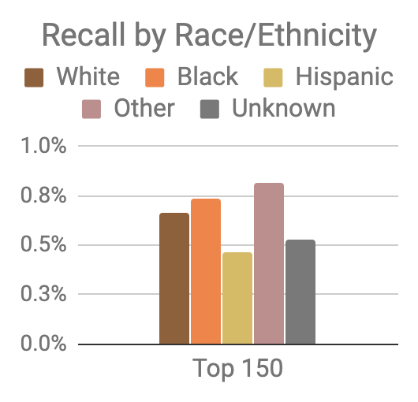
Model was optimized for efficiency, not equity
Top 150 highest risk reasonably balanced between black and white individuals
However, hispanic and unknown race/ethnicity groups very underrepresented

Slide 76
Mitigating Disparities
Single Threshold
White
Black
Hispanic
Recall
Lower Scores / Higher Recall
Group Thresholds
Recall

Slide 77
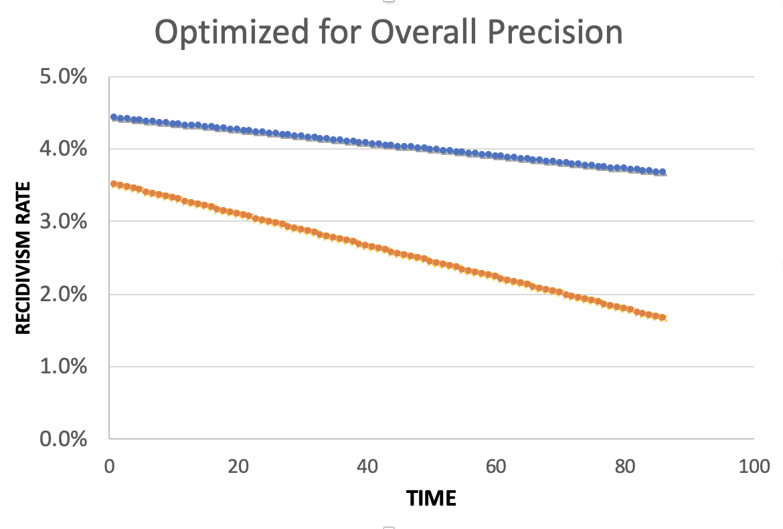
Equality of Predictions vs Underlying Disparities
Widening Gap:
Disparities Getting
Larger Over Time

Slide 78
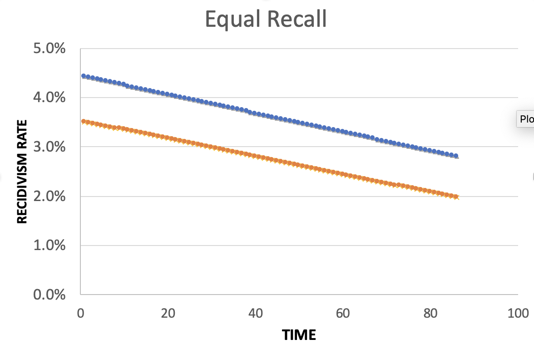
Equality of Predictions vs Underlying Disparities
Parallel Lines:
Disparities Remain
Constant Over Time

Slide 79
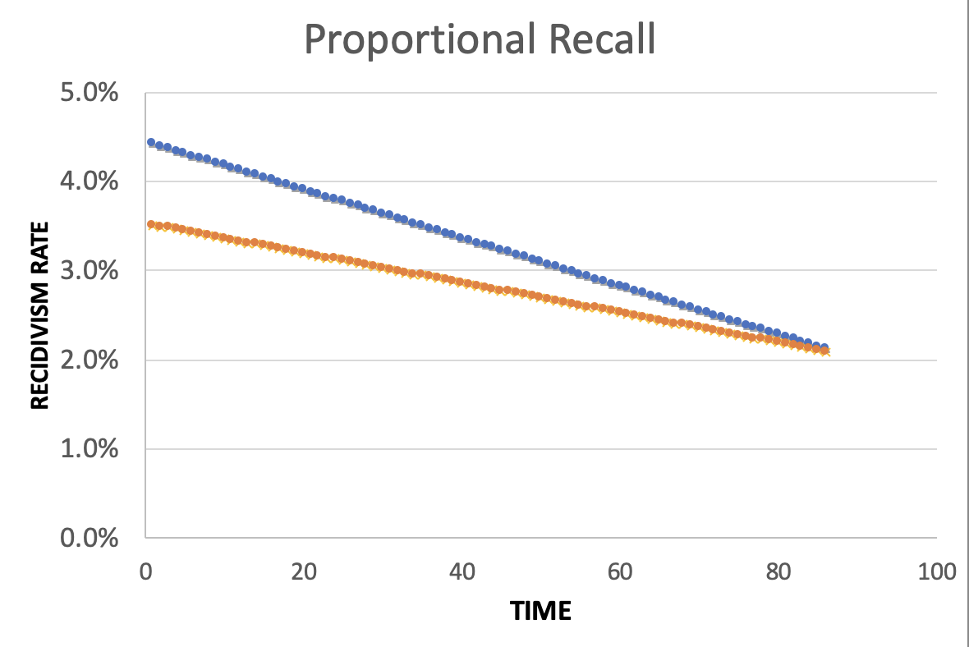
Equality of Predictions vs Underlying Disparities
Converging Lines:
Disparities Decrease
Over Time

Slide 81
Menu of Options
Current Scale
Expanded Scale
No
Constraint
Equalize
Recall
Reduce
Disparities

Slide 82
Menu of Options
Current Scale
Expanded Scale
No
Constraint
INITIAL
MODEL
Equalize
Recall
Reduce
Disparities

Slide 83
Menu of Options
Current Scale
Expanded Scale
No
Constraint
Equalize
Recall
EXPLICIT
EQUITY / EFFICIENCY
TRADE-OFF
“COST OF
EQUITY”
Reduce
Disparities

Slide 84
Menu of Options
Current Scale
Expanded Scale
No
Constraint
Equalize
Recall
IMPROVE OUTCOMES AT SAME
RATE ACROSS GROUPS
Reduce
Disparities
IMPROVE OUTCOMES FASTER FOR GROUPS
WITH HIGHER INCARCERATION RATES
Notes:
For the “Reduce Disparities” options, we targeted recall levels in proportion to underlying prevalence in the population. Could make other choices, but this has the nice property of readjusting as these prevalences change while also still distributing resources across all groups, but one could reasonably take many possible approaches.

Slide 85
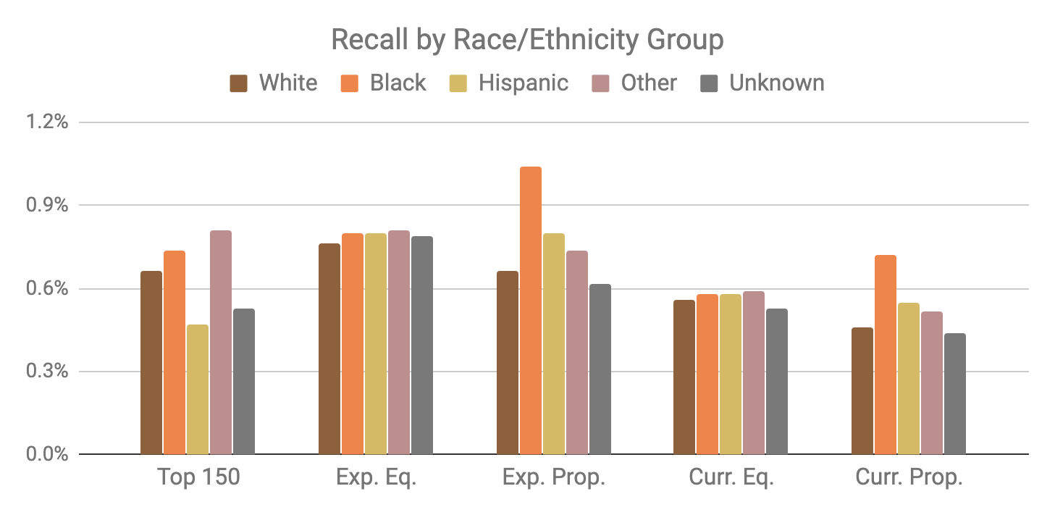
Base Model
Expanded Scale
Current Scale

Slide 86
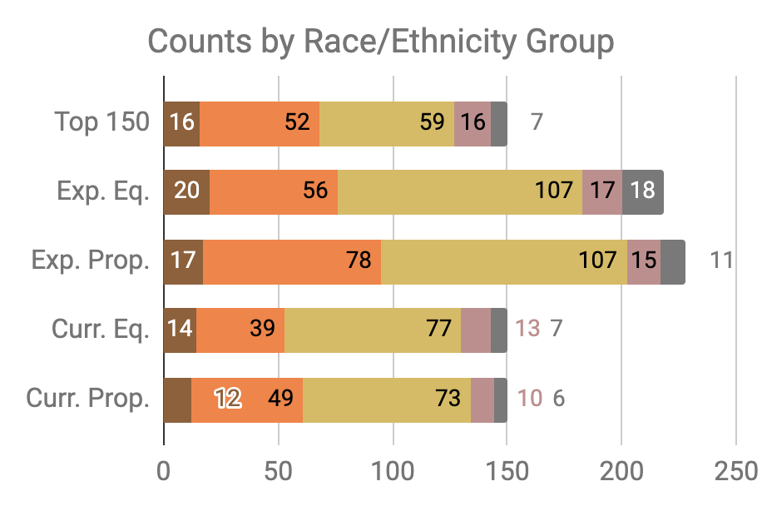

Slide 87
Little Equity/Efficiency Trade-Off at Current Scale
Top 150
72.7%
Precision
150
Total Count
Equal
Recall
70.7%
Precision
150
Total Count
Proportional
Recall
70.7%
Precision
150
Total Count

